Slide 1
Understanding Heart Disease Data
Francis Quimby

Slide 2
Table of Contents
Explanation of dataset
Early analysis
Next steps

Slide 3
Predicting Heart Failure - Data
The dataset is found on Kaggle and consists of 11 features, 1 target, and 918 observations.
The data combines these 11 common features from 5 different datasets
Source: Heart Failure Prediction Dataset | Kaggle

Slide 4
Data Attributes
Age: age of the patient [years]
Sex: sex of the patient [M: Male, F: Female]
ChestPainType: chest pain type [TA: Typical Angina, ATA: Atypical Angina, NAP: Non-Anginal Pain, ASY: Asymptomatic]
RestingBP: resting blood pressure [mm Hg]
Cholesterol: serum cholesterol [mm/dl]
FastingBS: fasting blood sugar [1: if FastingBS > 120 mg/dl, 0: otherwise]
RestingECG: resting electrocardiogram results [Normal: Normal, ST: having ST-T wave abnormality (T wave inversions and/or ST elevation or depression of > 0.05 mV), LVH: showing probable or definite left ventricular hypertrophy by Estes' criteria]
MaxHR: maximum heart rate achieved [Numeric value between 60 and 202]
ExerciseAngina: exercise-induced angina [Y: Yes, N: No]
Oldpeak: oldpeak = ST [Numeric value measured in depression]
ST_Slope: the slope of the peak exercise ST segment [Up: upsloping, Flat: flat, Down: downsloping]
HeartDisease: output class [1: heart disease, 0: Normal]
Source: Kaggle

Slide 5
Initial look at the data
Data is relatively clean and well-populated
Very challenging to differentiate the target given the input variables

Slide 6
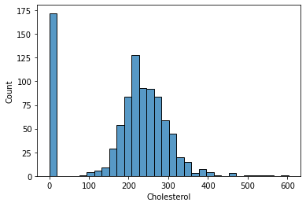
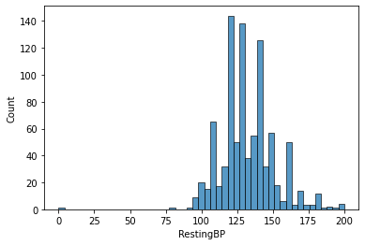
Cleaning & Analyzing Data
Missing Cholesterol Obs
Few Missing RestingBP Obs

Slide 7
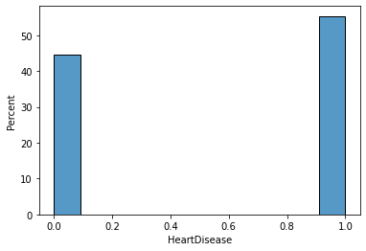
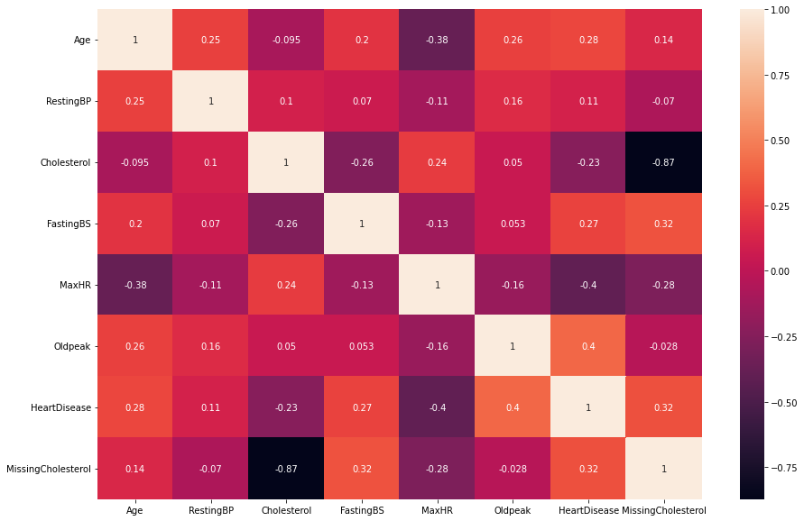
Target is slightly unbalanced, dataset correlations are weak
Correlation matrix is tepid
Target is 0:1 by 45:55

Slide 8
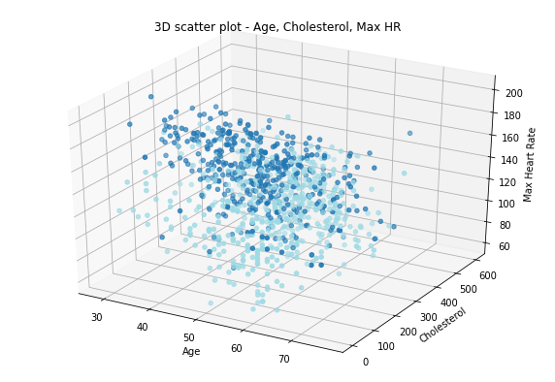
Very challenging to differentiate observations by the existing data

Slide 9
Next steps
Additional exploratory data - review conditional relationships
Clustering analysis to uncover additional segments for analysis
Run models

Slide 10
Appendix

Slide 11
Dataset Creators
Hungarian Institute of Cardiology. Budapest: Andras Janosi, M.D.
University Hospital, Zurich, Switzerland: William Steinbrunn, M.D.
University Hospital, Basel, Switzerland: Matthias Pfisterer, M.D.
V.A. Medical Center, Long Beach and Cleveland Clinic Foundation: Robert Detrano, M.D., Ph.D.
Donor:
David W. Aha (aha '@' ics.uci.edu) (714) 856-8779
Source: Kaggle

Slide 12
Dataset Creation
This dataset was created by combining different datasets already available independently but not combined before. In this dataset, 5 heart datasets are combined over 11 common features which makes it the largest heart disease dataset available so far for research purposes. The five datasets used for its curation are:
Cleveland: 303 observations
Hungarian: 294 observations
Switzerland: 123 observations
Long Beach VA: 200 observations
Stalog (Heart) Data Set: 270 observations
Total: 1190 observations
Duplicated: 272 observations
Every dataset used can be found under the Index of heart disease datasets from UCI Machine Learning Repository on the following link: https://archive.ics.uci.edu/ml/machine-learning-databases/heart-disease/
Source: Kaggle

Slide 13
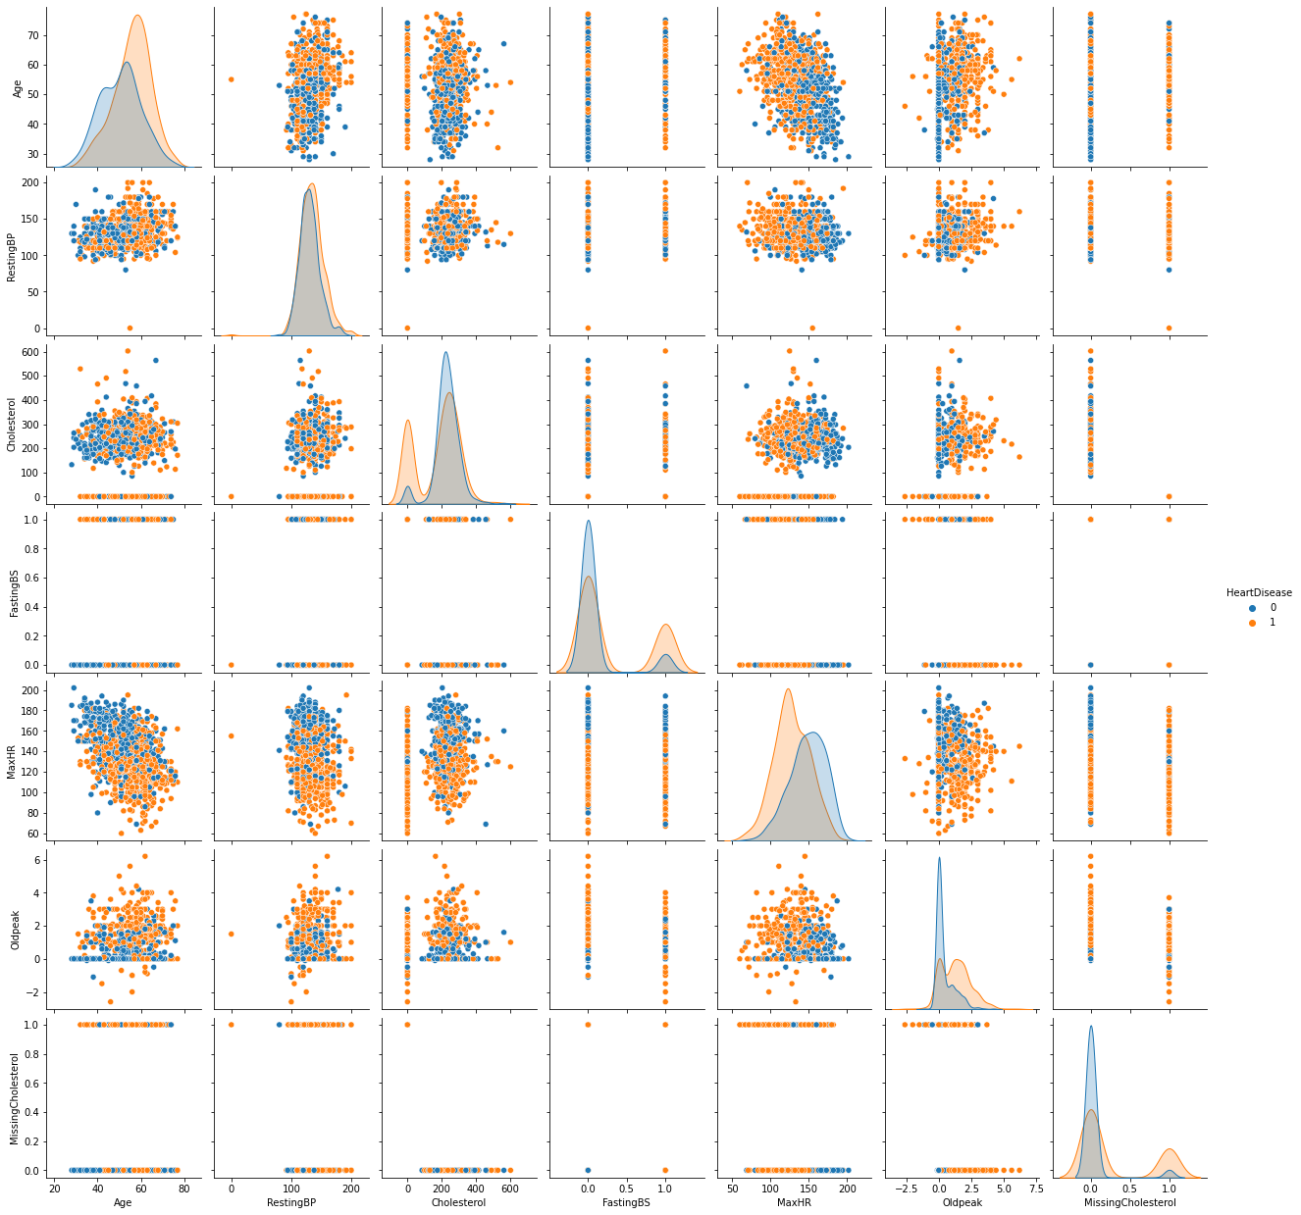
Pairplots of the data are very challenging to segregate.

